Slide 1
DSP w2 sampling

Slide 2
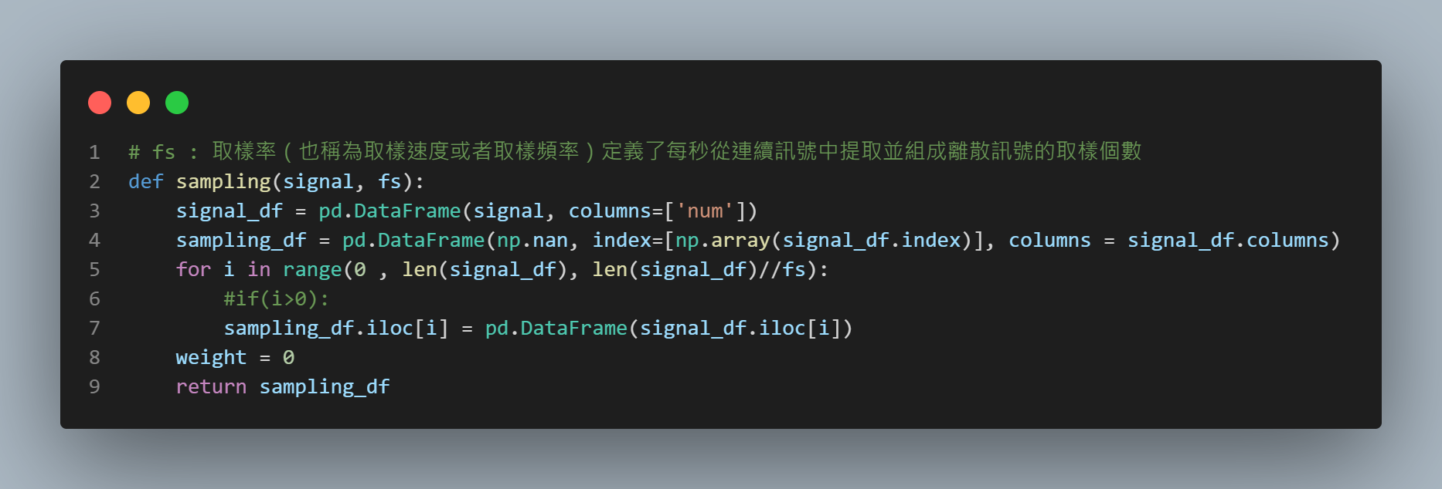
Sampling define

Slide 3
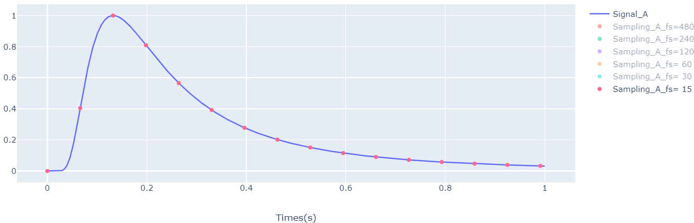
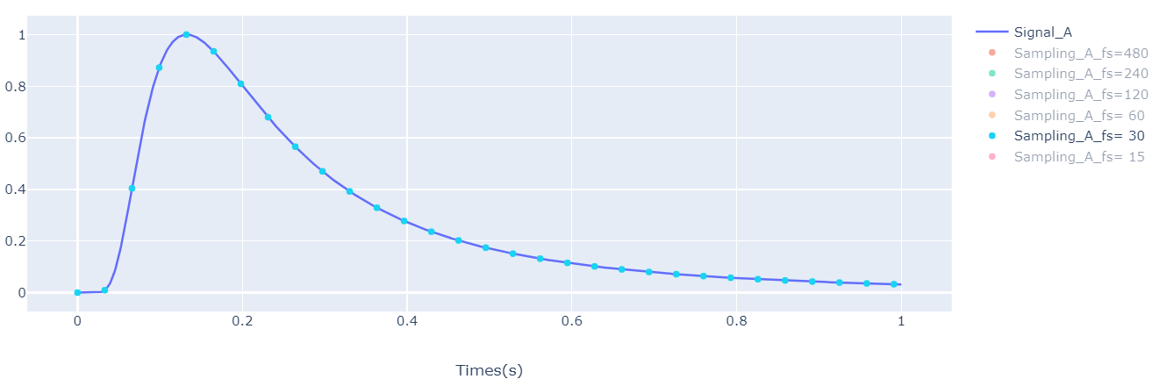
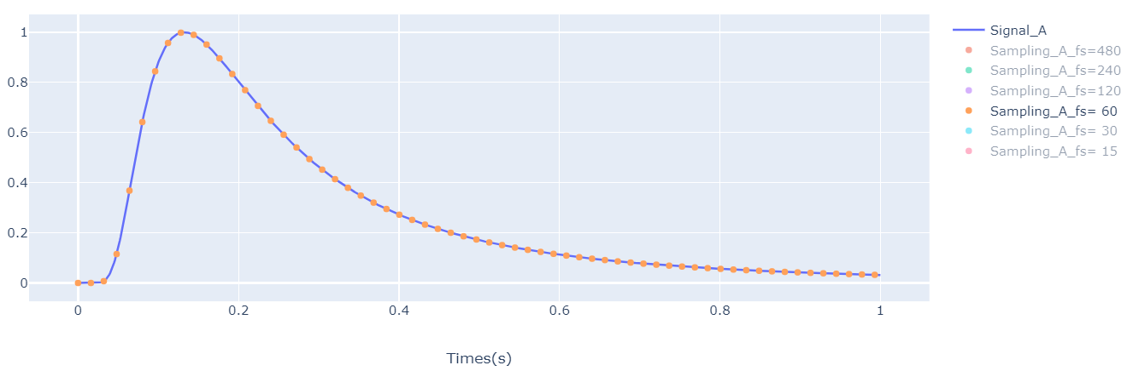
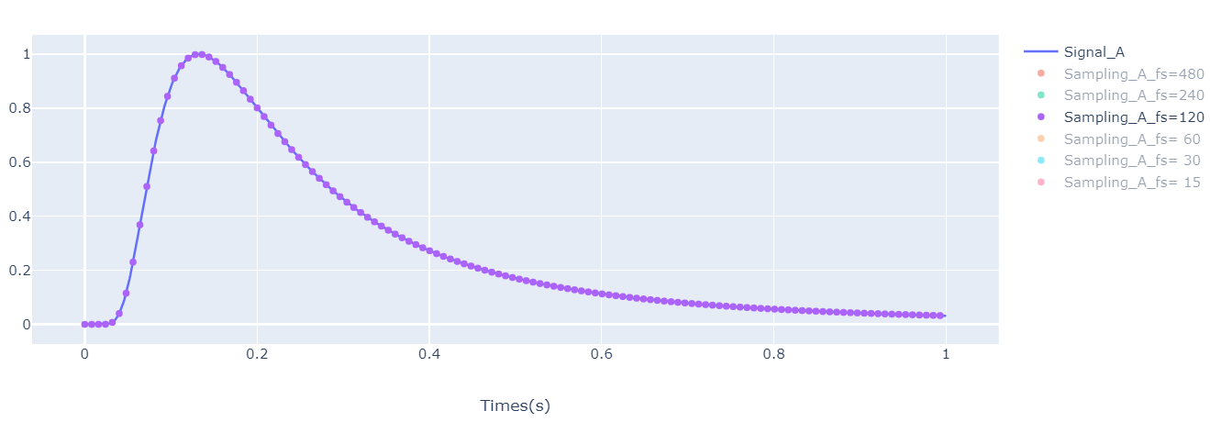
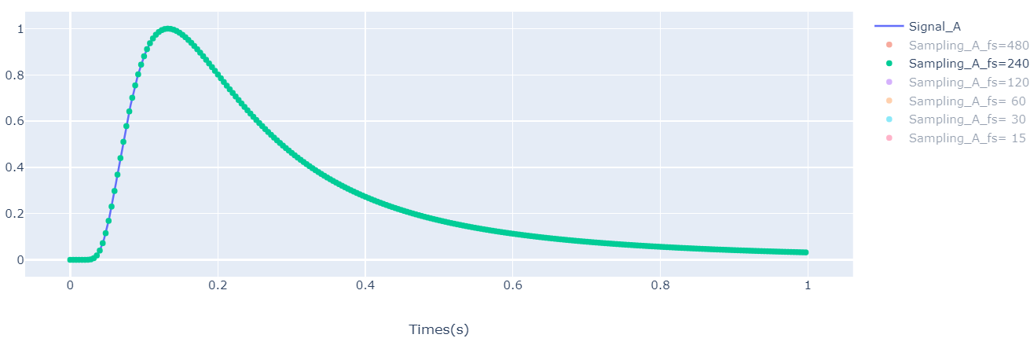
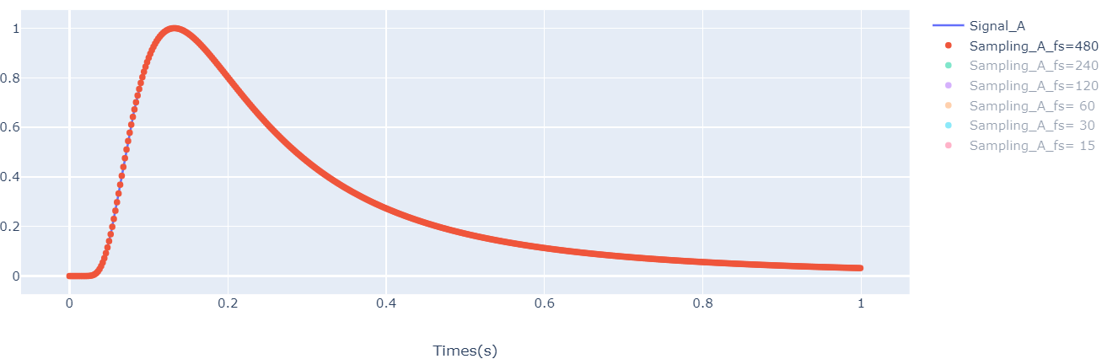
Display sampling signal with original signal (A)

Slide 4
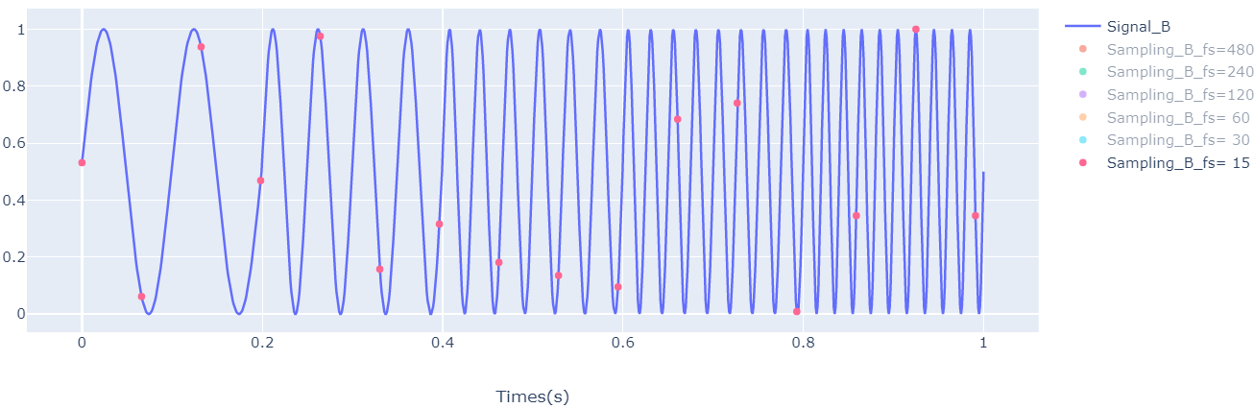
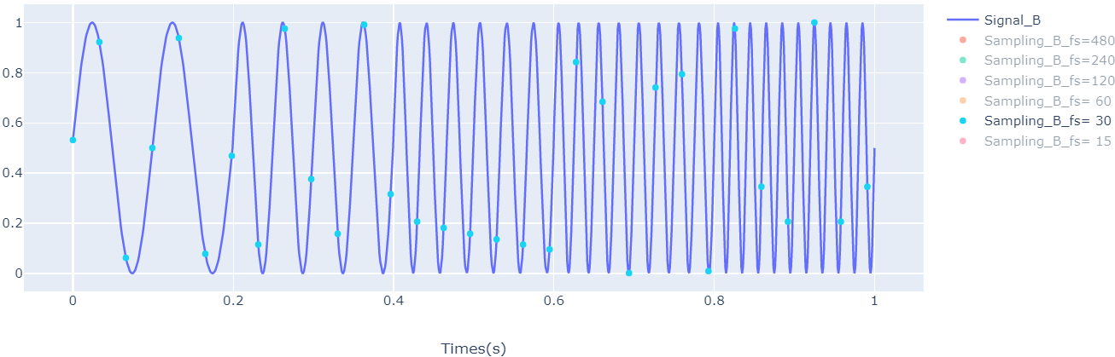
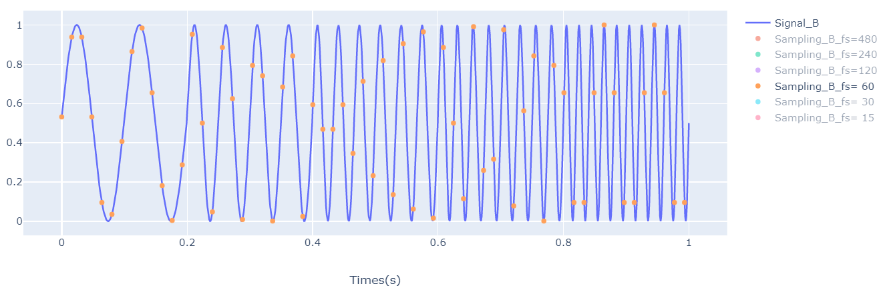
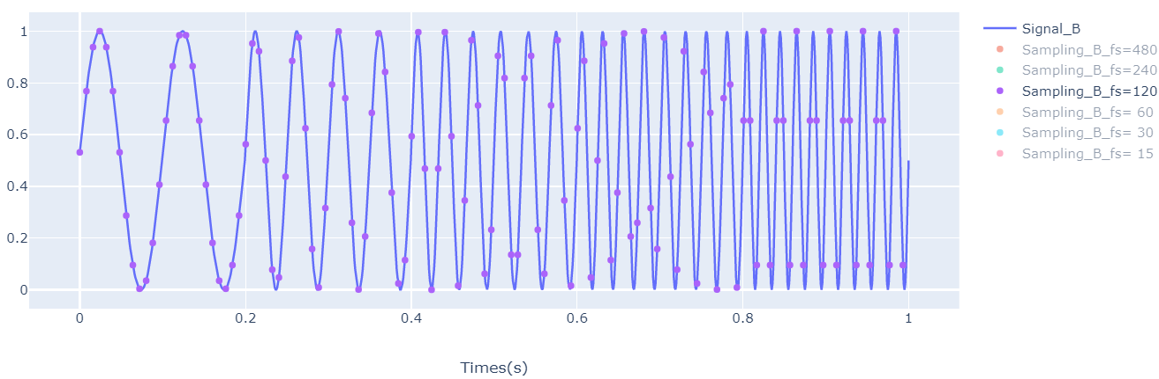
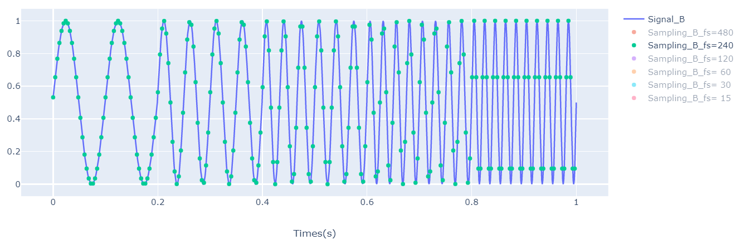
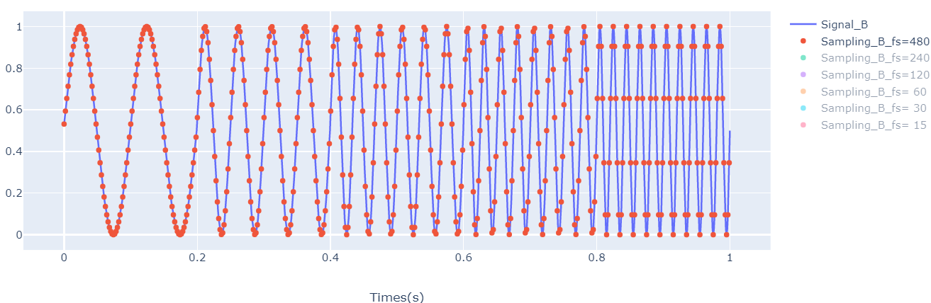
Display sampling signal with original signal (B)

Slide 5
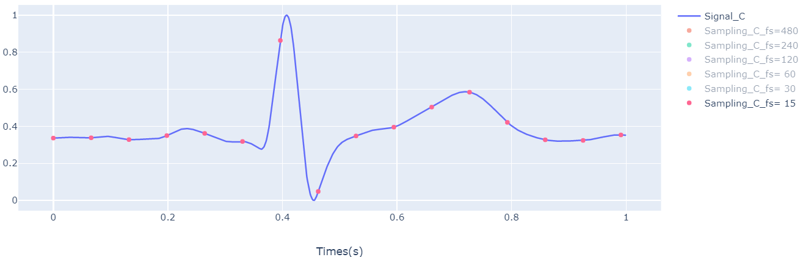
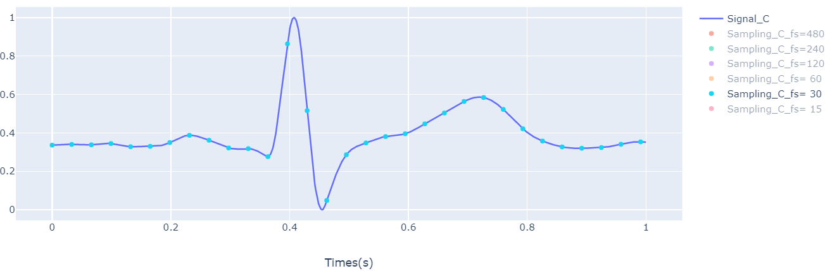
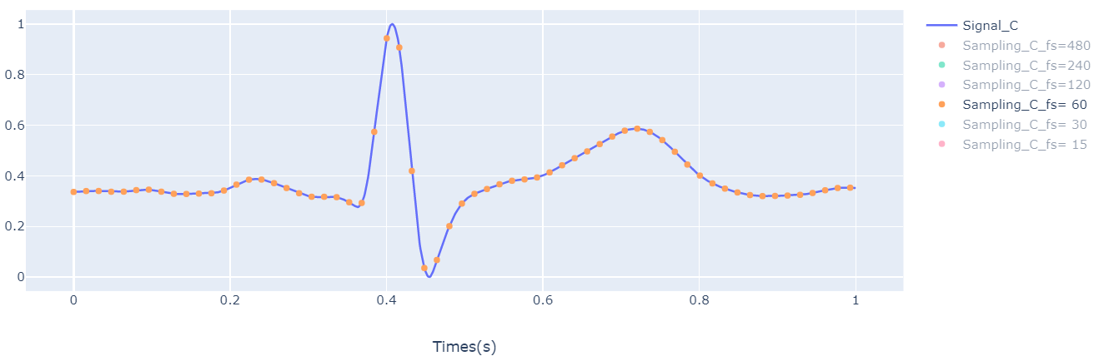
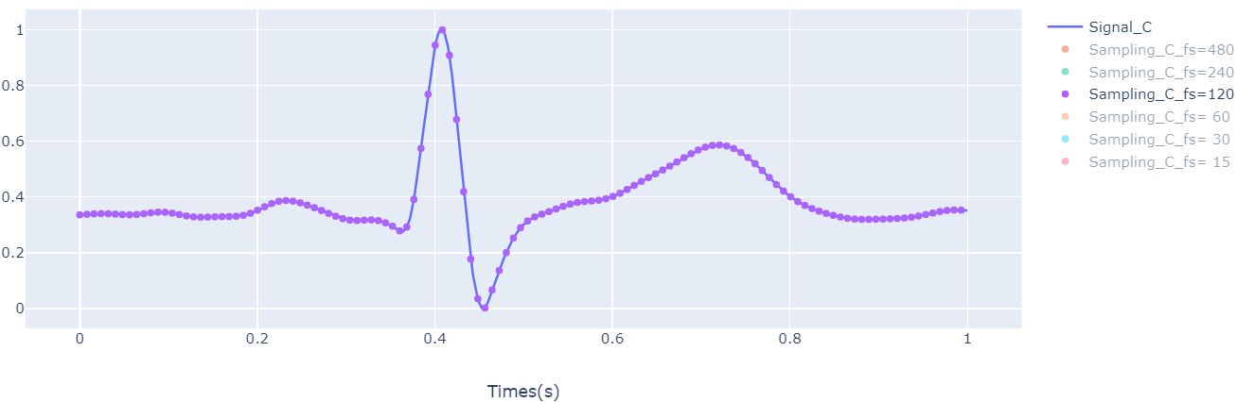
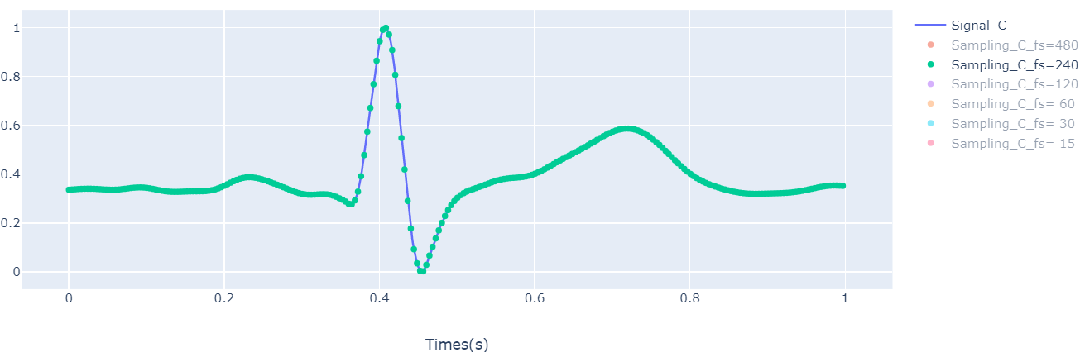
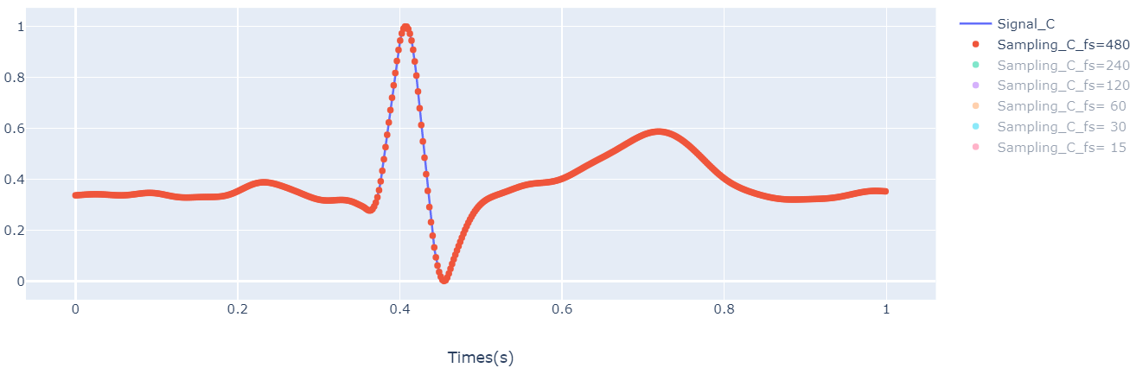
Display sampling signal with original signal (C)

Slide 6
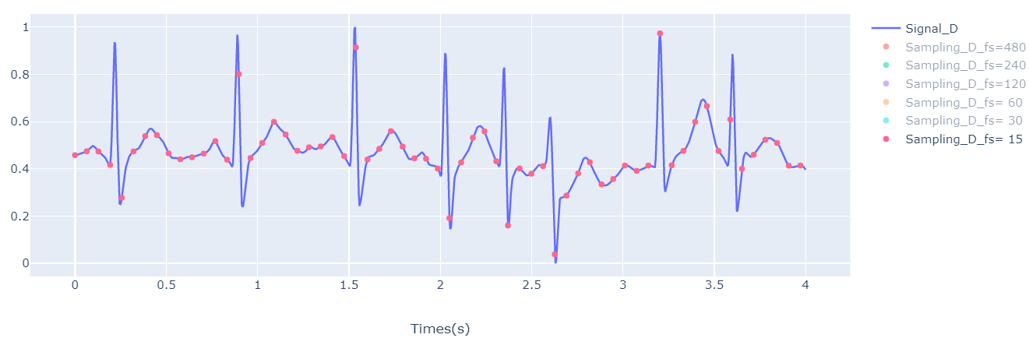
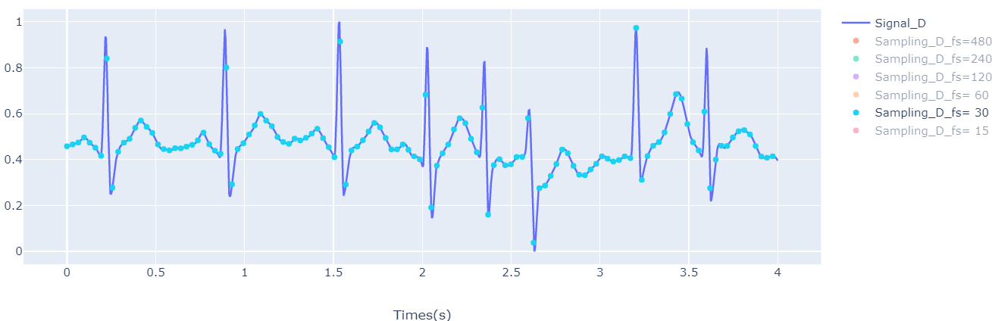
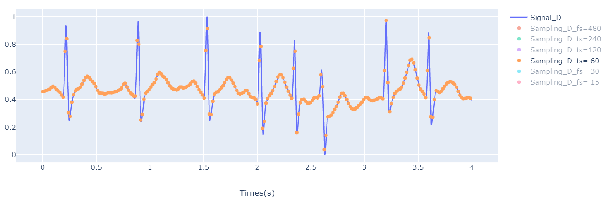
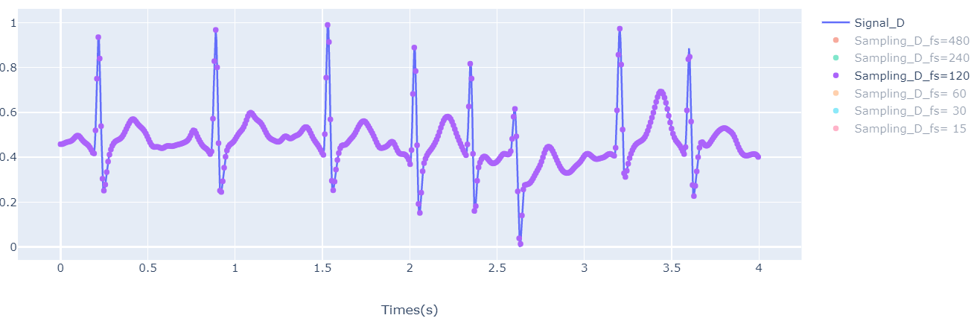
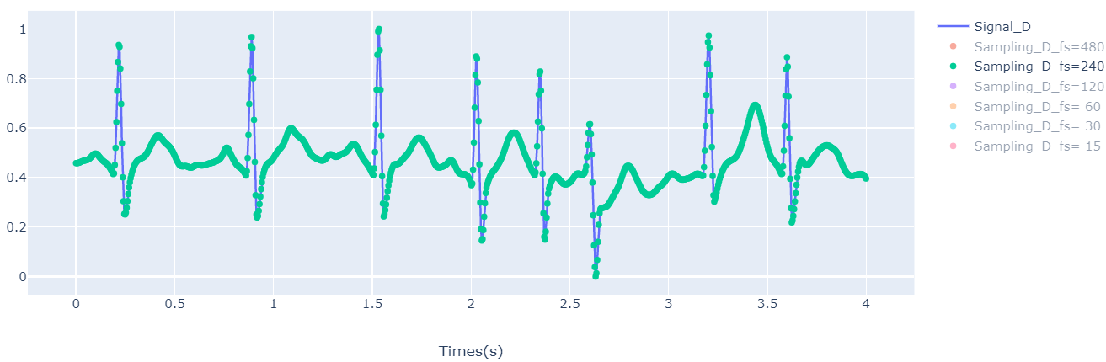
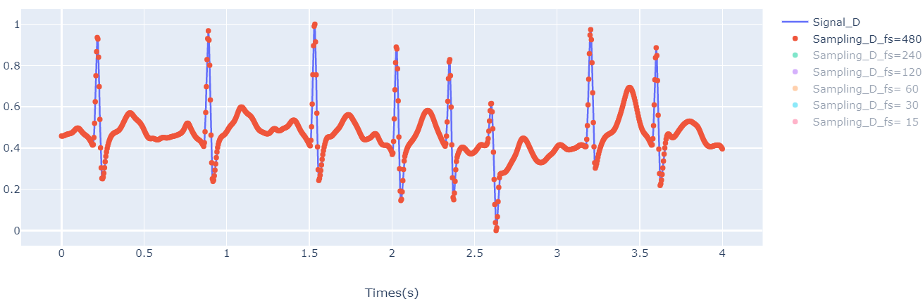
Display sampling signal with original signal (B)

Slide 7
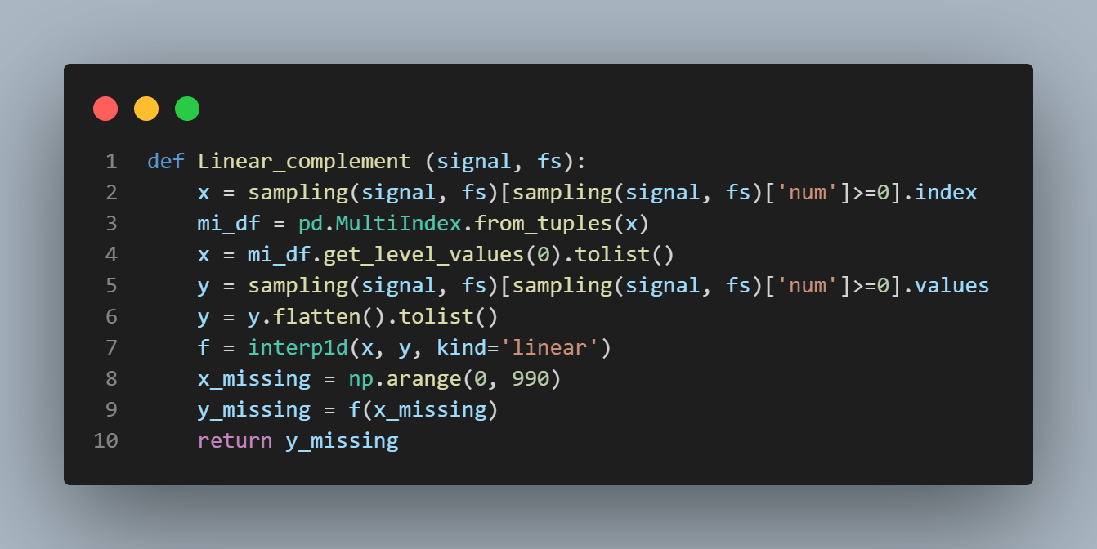
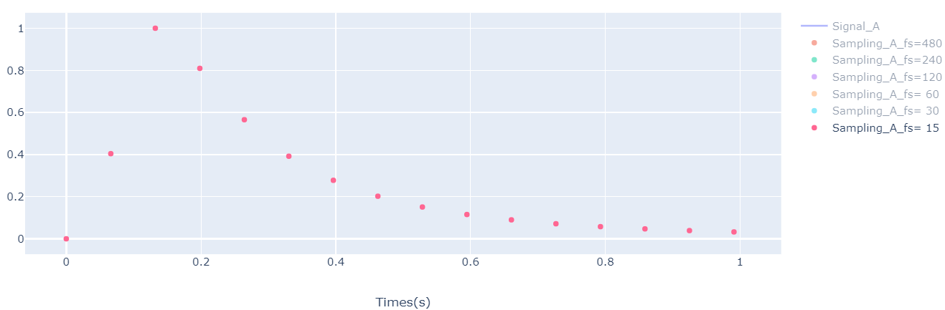
Linear complement

Slide 8
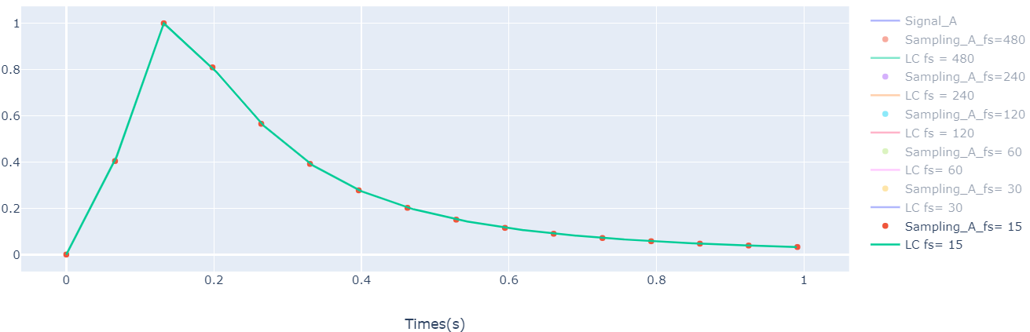
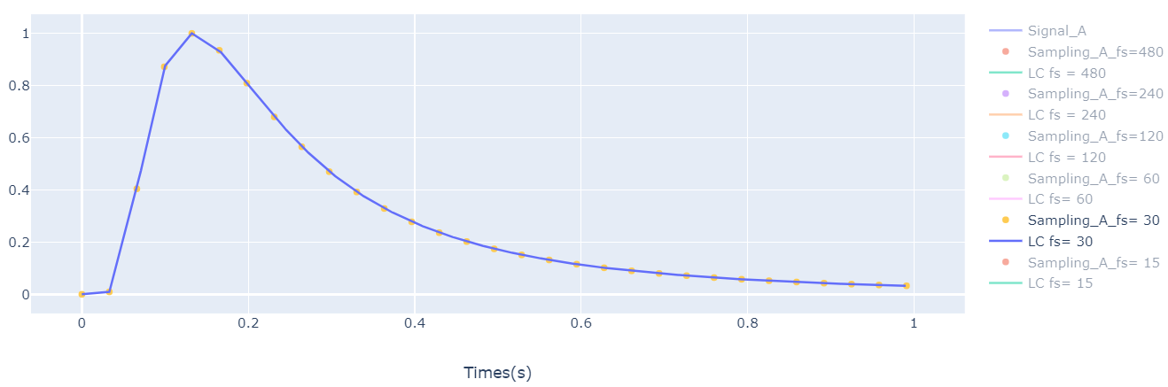
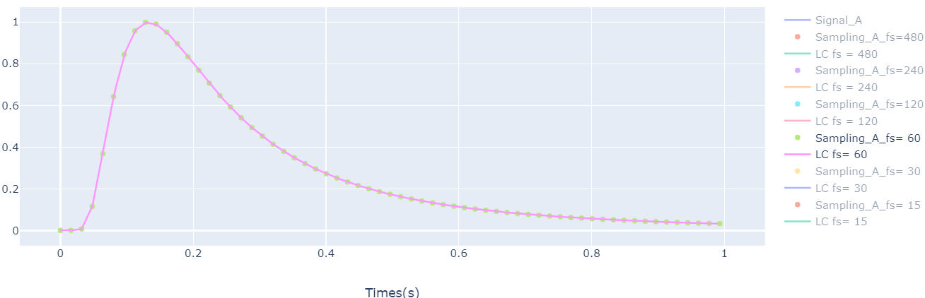
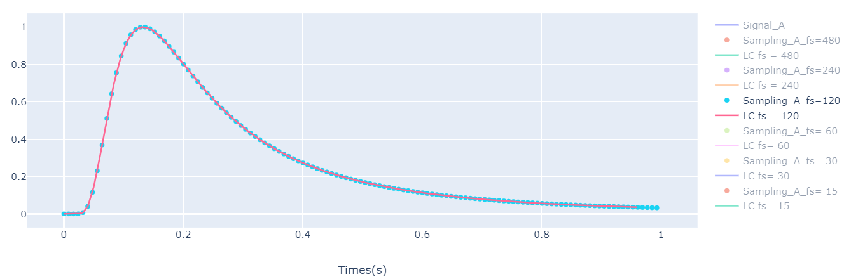
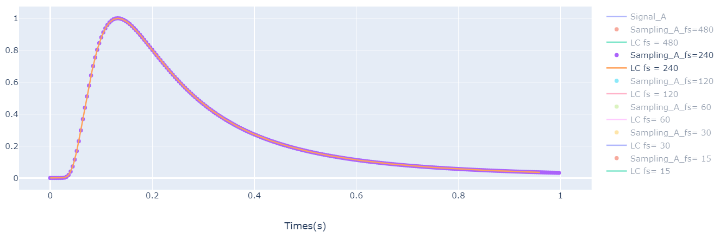
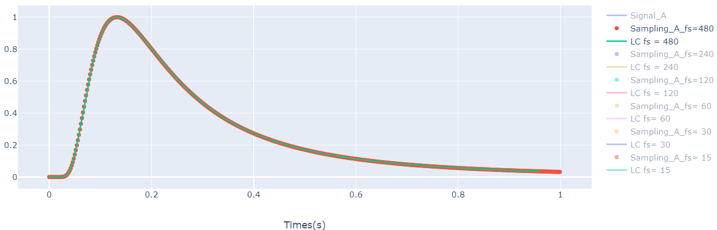
Sampling A with LC

Slide 9
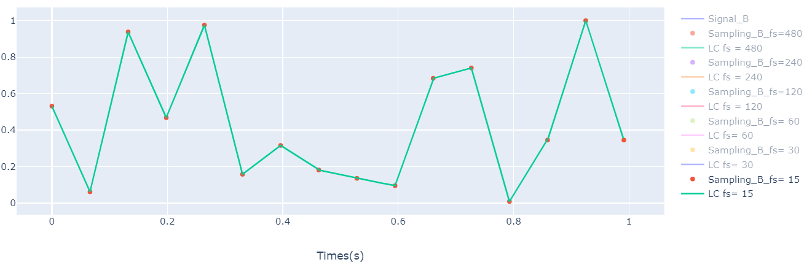
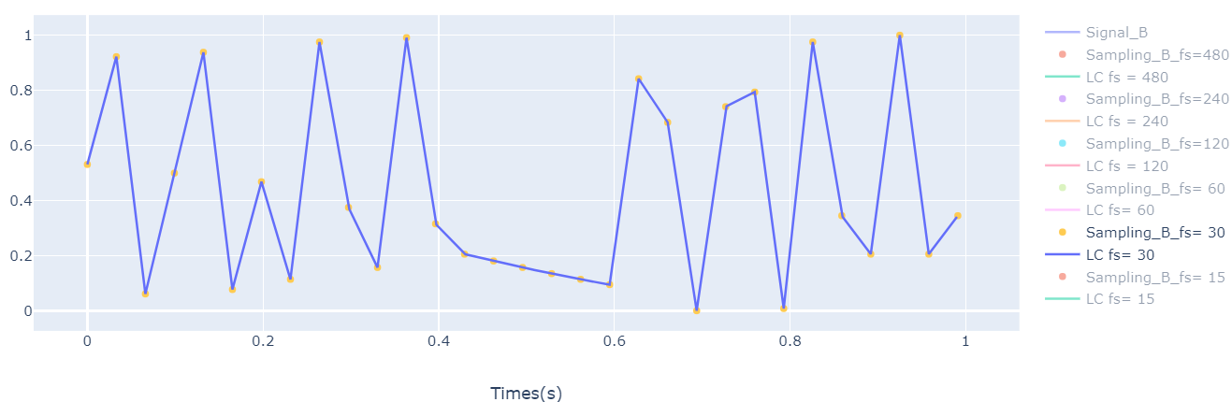
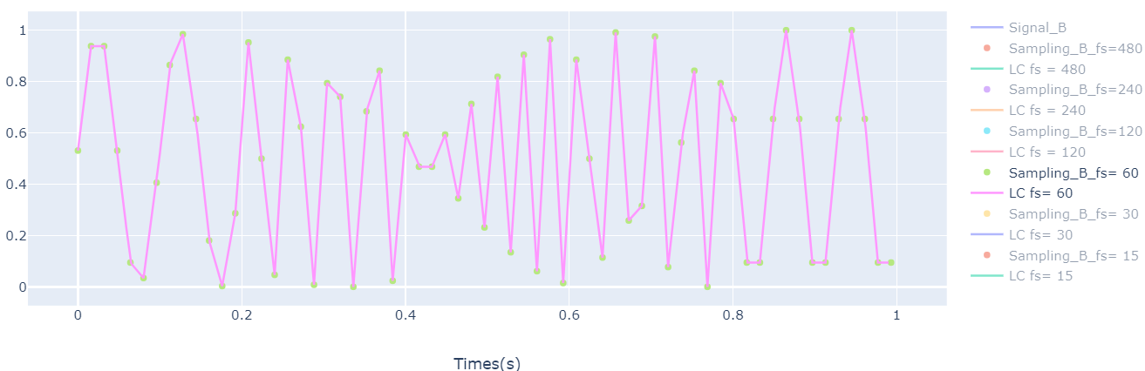
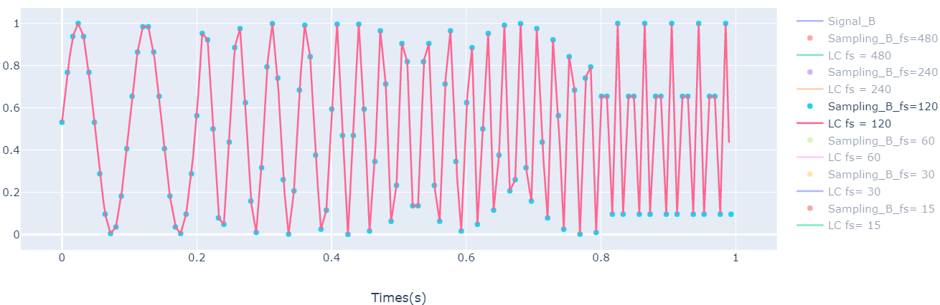
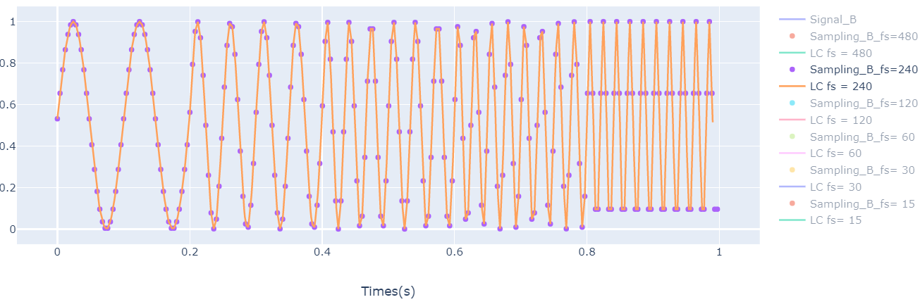
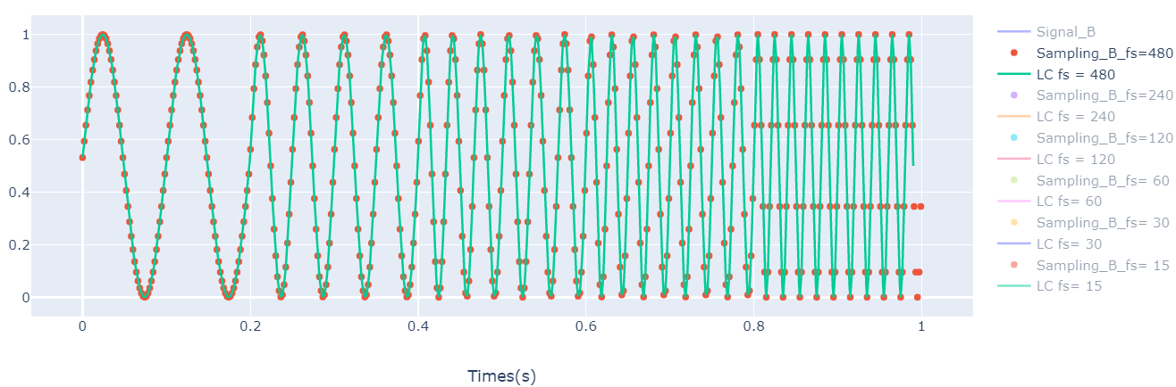
Sampling B with LC

Slide 10
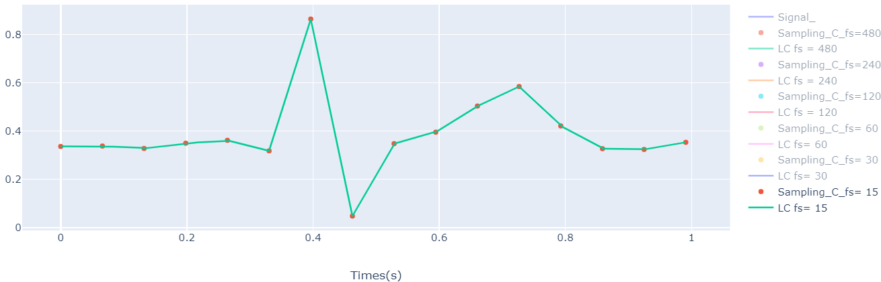
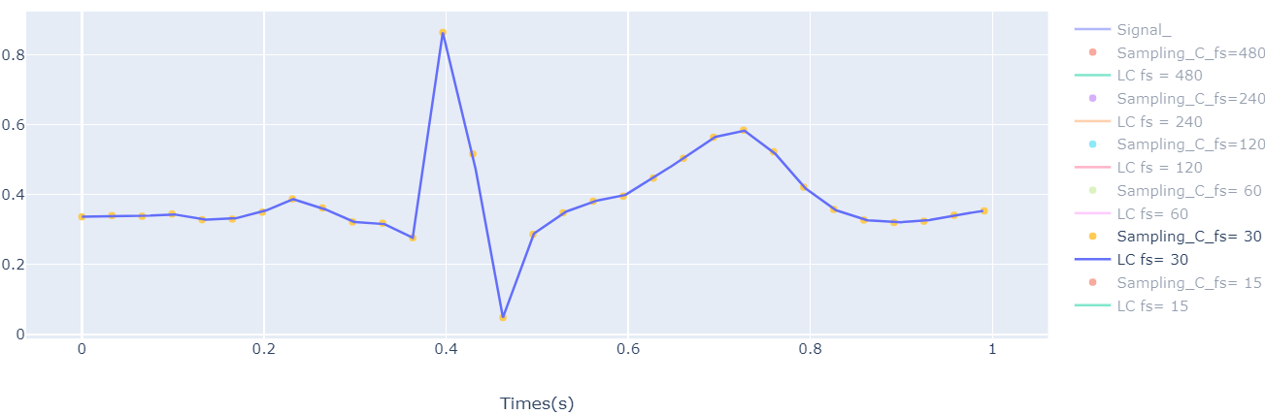
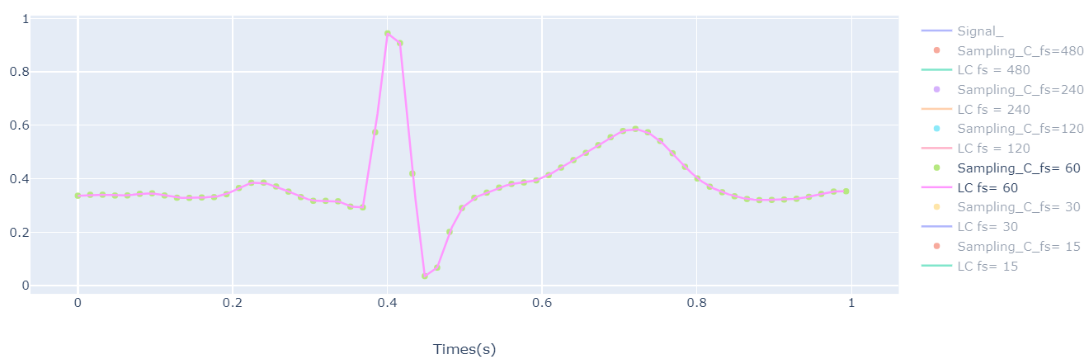
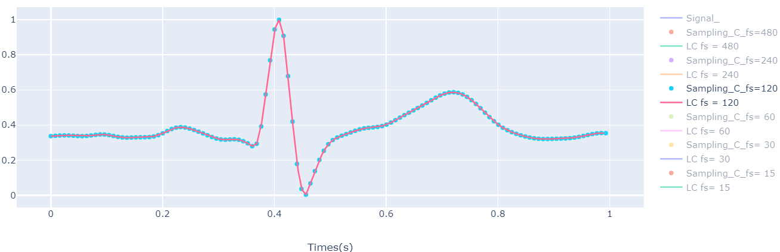
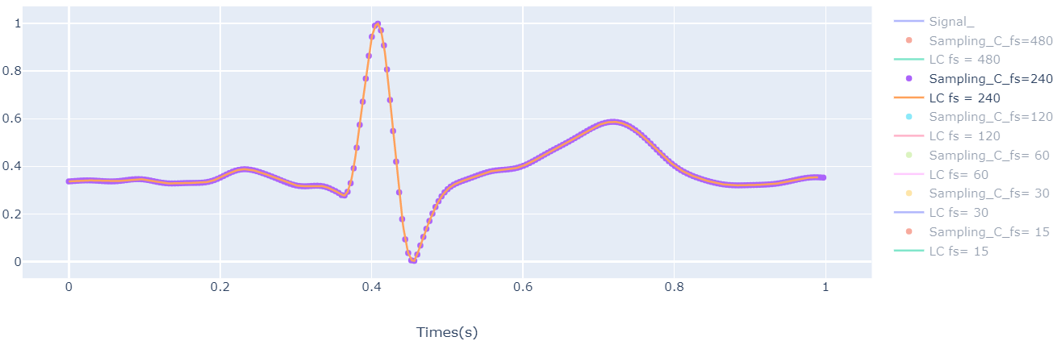
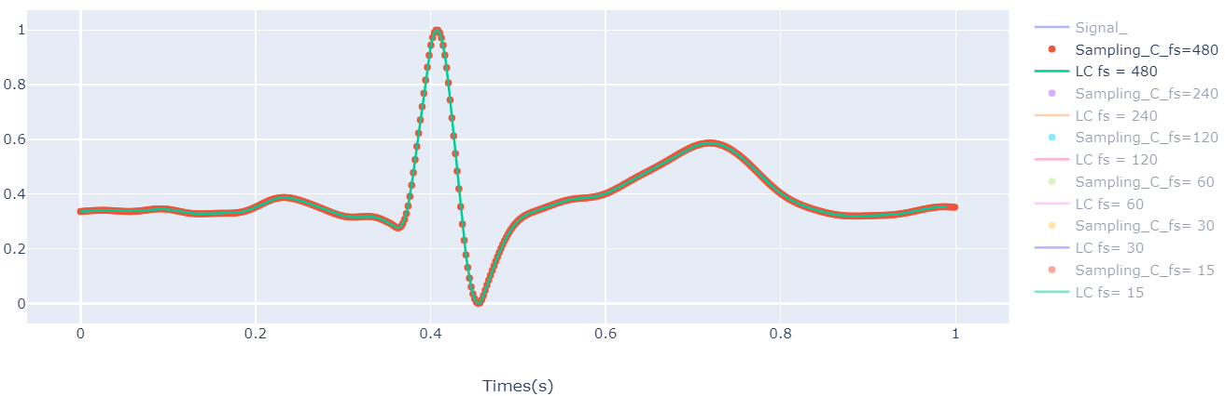
Sampling C with LC

Slide 11
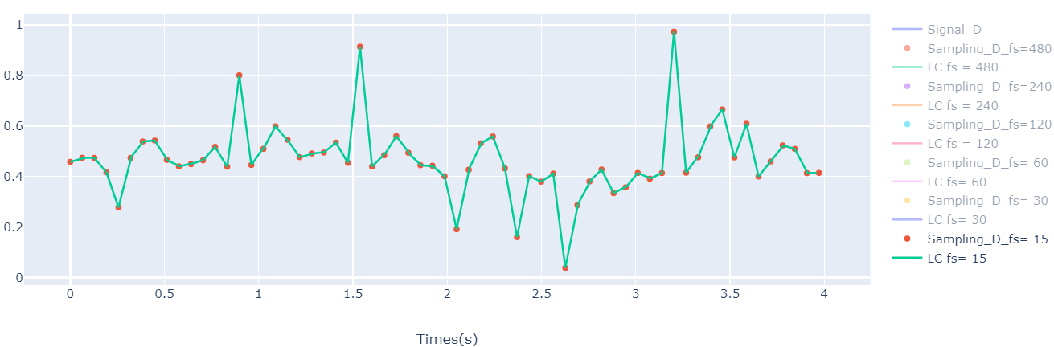
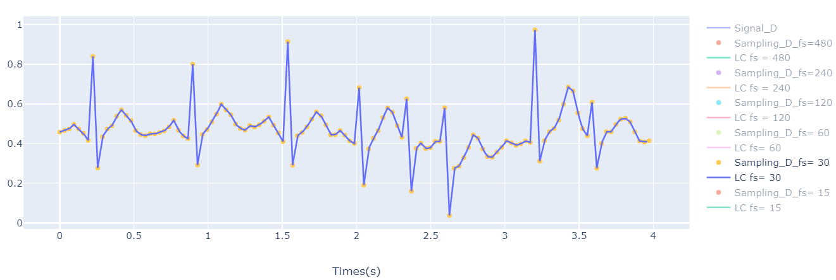
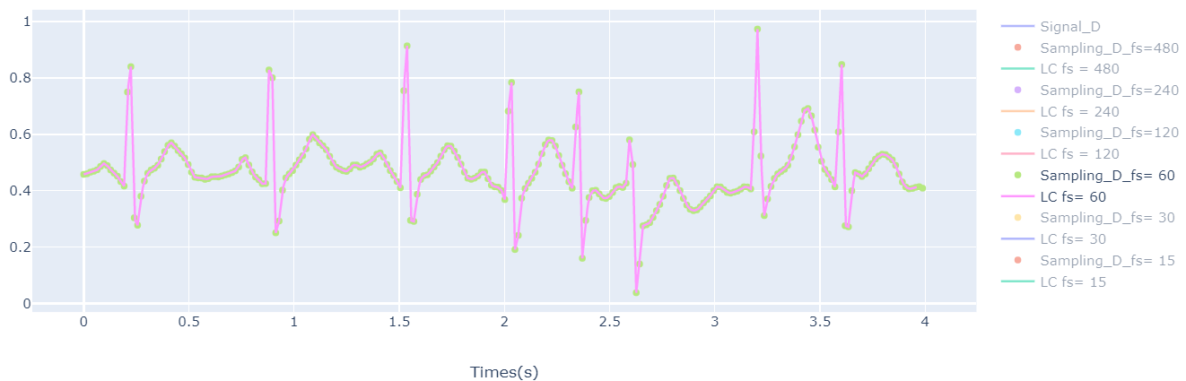
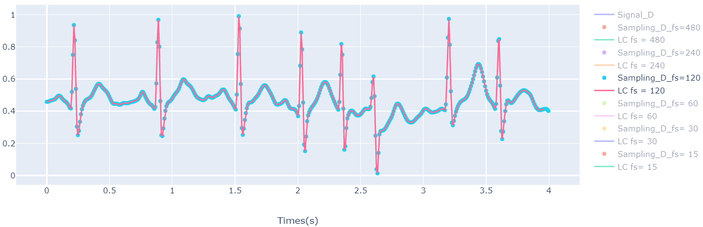
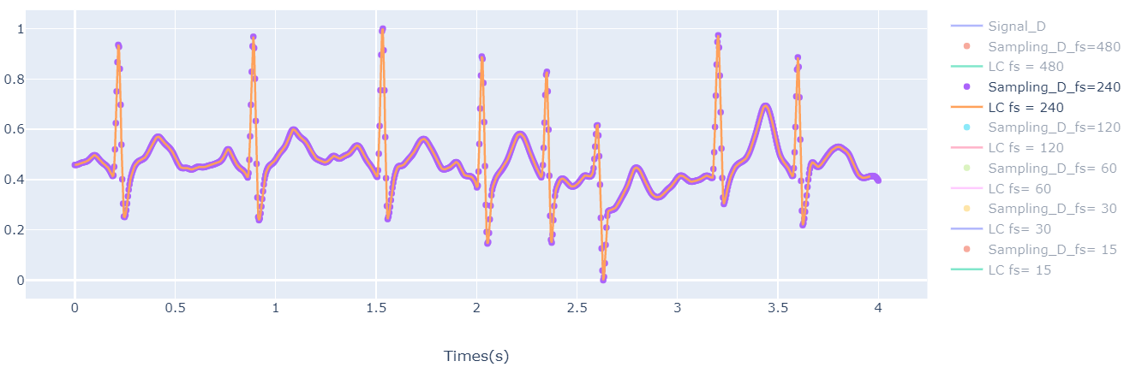

Sampling D with LC

Slide 12

Total MAE
Sampling rate | 480 | 240 | 120 | 60 | 30 | 15
Signal
A | 1.23e-05 | 5.79e-05 | 2.4e-04 | 9.4e-04 | 0.00413 | 0.01833
B | 0.00327 | 0.01626 | 0.06290 | 0.20351 | 0.29909 | 0.35274
C | 4.30e-05 | 2.09e-04 | 8.70e-04 | 0.00337 | 0.01543 | 0.03342
D | 0 | 0 | 0.00147 | 0.00658 | 0.02024 | 0.04697

Slide 13

Interval MAE for signal A

Slide 14


Slide 15


Slide 16



Slide 17


Slide 18

Interval MAE for signal B

Slide 19
Sampling rate | 480 | 240 | 120 | 60 | 30 | 15
Signal
A | 1.23e-05 | 5.79e-05 | 2.4e-04 | 9.4e-04 | 0.00413 | 0.01833
B | 0.00327 | 0.01626 | 0.06290 | 0.20351 | 0.29909 | 0.35274
C | 4.30e-05 | 2.09e-04 | 8.70e-04 | 0.00337 | 0.01543 | 0.03342
D | 0 | 0 | 0.00147 | 0.00658 | 0.02024 | 0.04697

Slide 20



Slide 21


Slide 22



Slide 23

Interval MAE for signal C

Slide 24




Interval MAE for signal C

Slide 25

Interval MAE for signal D

Slide 26





Slide 27





